Slide 1
Jacob Cody 7th period 1/3/13
What I did on my break

Slide 2
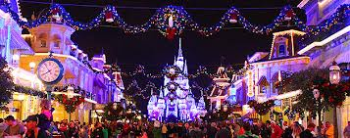
I went to a Christmas party

Slide 3
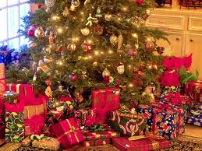
I hade my Christmas with family

Slide 4
I went to my family’s New Year’s party

Slide 5
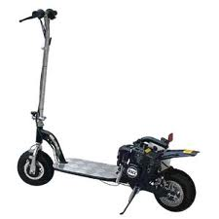
I got a gas powered schoter

Slide 6
I got to spend a lot of time with my family

Slide 7
Im glad to be back in school because I can hang out with my friends

